Slide 1
Biodiversity One

Slide 2
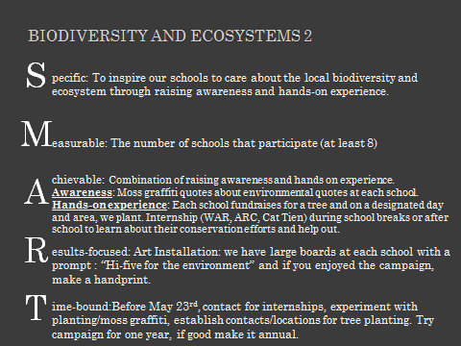
Biodiversity Two

Slide 3
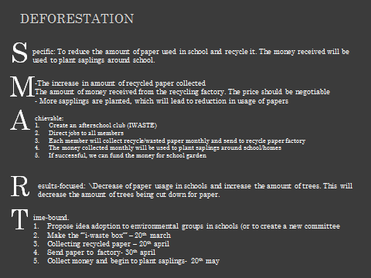
Deforestation

Slide 4
Fisheries Depletion

Slide 5
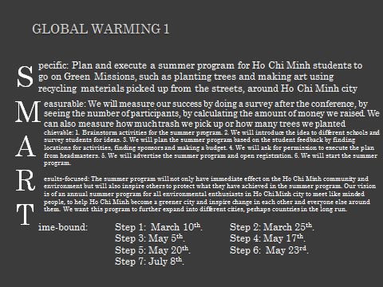
Global Warming One

Slide 6
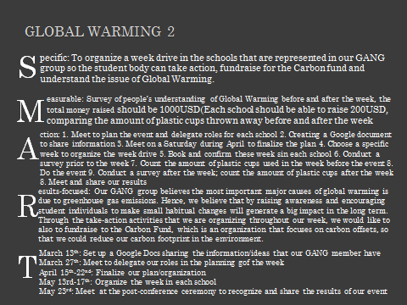
Global Warming Two

Slide 7
Global Warming Three
Coming separately.

Slide 8
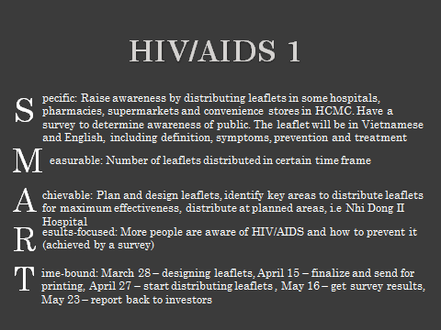
HIV/AIDS One

Slide 9
HIV/AIDS 2
S
M
A R
T
pecific: To educate local/public high schools of the importance and consequences of HIV/AIDS. Through hiring local sex education specialists that teach safe sex and through the distribution of shirts, bracelets, wrist bands etc. that promote safe sex.
easurable: Each student will be given a questionnaire that they must fill out before and after, thus we can accurately determine what they have learnt through the lesson and what lessons they have retained.
chievable: Begin with the design of merchandise and come into contact with companies/stores/people who are capable of creating our products.
Come into contact with local clinics and hospitals and find volunteers that can hold presentation and hire them. Choose local/public school and negotiate time for presentation. Hold presentation and distribute merchandise.
esults-focused: Our vision is that the local population will be more aware of HIV/AIDS in their community and are more conscious of safe sex and will take effort to avoid getting infected.
ime-bound: We want to distribute different jobs among the seven participants in our GANG, so that when we meet again on the 23rd of May we have completed the preparations for the safe sex lessons. Creation of merchandise, people found for sex education lessons, school found, time for lessons set. 2 people or 1 person for each job. Therefore, after the 23rd of May meeting we can bring our work together and actually only need to the lessons for safe sex.

Slide 10
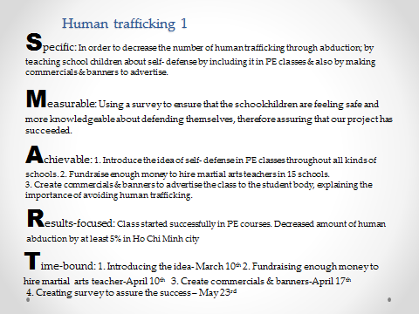
Human Trafficking

Slide 11
GanG Group Name: Traffic jam
S
M
A
R
T
pecific: To raise awareness about human trafficking to schools in Vietnam, due to the fact that Human Trafficking is not a global issue that is well known in Vietnam.
easurable:
- Count the number of students in schools that are aware of human trafficking, by the use of survey, or a quiz. (keep in track of the students in the school whether or not they are aware of human trafficking).
- Make students sign a pledge, to take care of themselves, and count the number of pledges.
chievable:
- Use PSA Video, Act/Skit (for public schools that has no access to technology), Social Networks (Facebook, Twitter) to raise awareness for schools in Vietnam
- Make a lesson plan that introduces the global issue to the students
What is human trafficking?
Who can become a victim?
Where does it usually happen? Situations that could lead to human trafficking
Ways to keep yourself and others around you safe
- Make students write a pledge about keeping themselves safe
- Give out statement bracelets that has the statement ‘”Not for sale’” to students
esults-focused: If our proposal is successful, the results will be that the local schools and VN public school will be aware of Human Trafficking. Students will take more precaution, in their decision that may lead to human trafficking, whether it is indirect or direct.
ime-bound: In 2 months

Slide 12
Illegal Drugs One

Slide 13
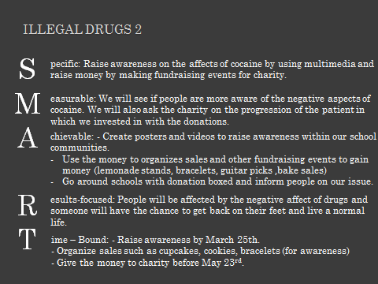
Illegal Drugs Two

Slide 15
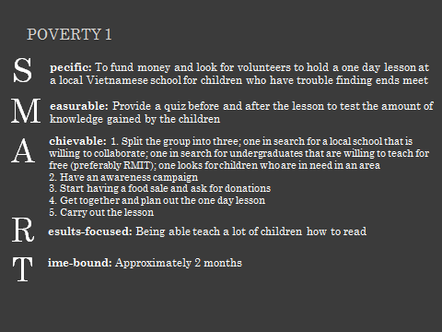
Poverty One

Slide 16
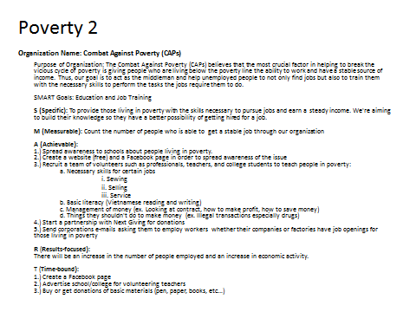
Poverty Two

Slide 17
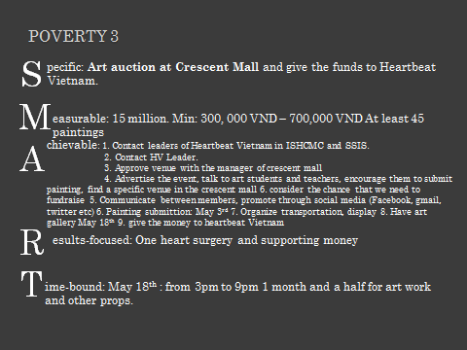
Poverty Three

Slide 19
Natural Disasters

Slide 20
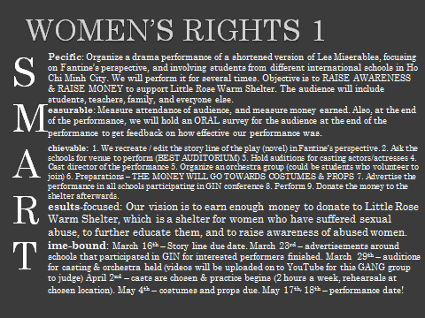
Women One

Slide 21
GanG GrouP: Women’s rights/protection 2
Specific: Fundraising to support educational, recreational and vocational programs for women in Vietnam by hosting an Art Auction Event (gallery, souvenir selling, refreshments, musical entertainment included)
Measurable: The amount of tickets we’ve sold for the event.
Achievable:
Place: At any school’s auditorium/gym
Artwork: Submitted by artists of Little Rose Shelter Charity (the organization we’re donating to) + Students/Teachers/Any others who are interested
Promotion: Video + Internet + Announcements + Edmodo + Posters
Results-focused: How many women we’ve supported based on the money we’ve raised from the event (this information can be provided from the Little Rose Shelter Charity, where we’re donating our money to)
Time-bound:
promotion date (recruiting the artists/music performers)
Rehearsal (speeches + music)
Event time: 6:30-7:00p.m. (gallery), 7:00-9:00p.m. (art auction + opening + closing ceremony)

Slide 22
Women Three

